Slide 2
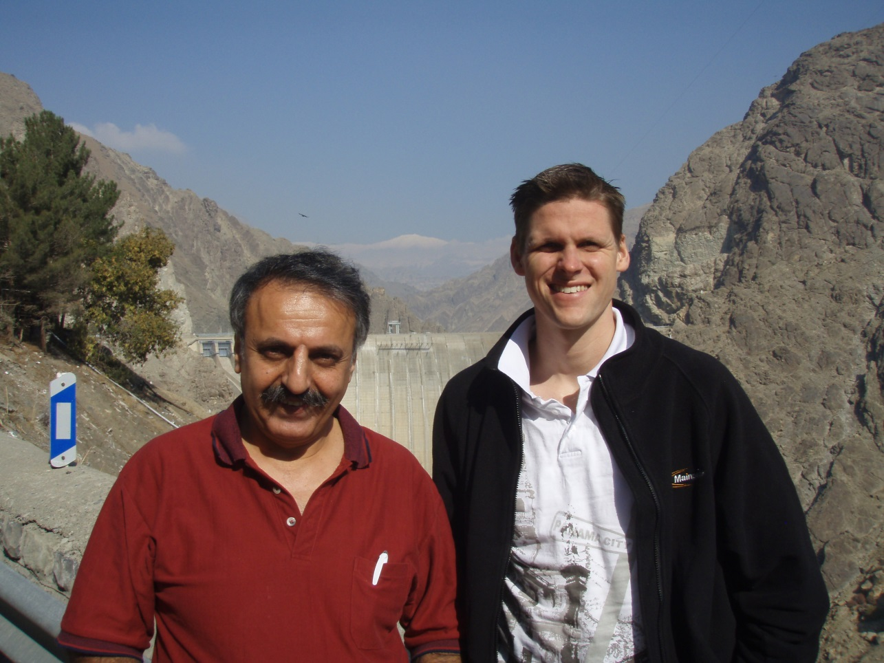

Slide 3
Mark 8:27-30 We follow Jesus because He is King.

Slide 4
‘Wonderful Counsellor, Mighty God, Evelasting Father, Prince of Peace’ Isaiah 9:7

Slide 5
Mark 8:27-30 We follow Jesus because He is King.

Slide 6
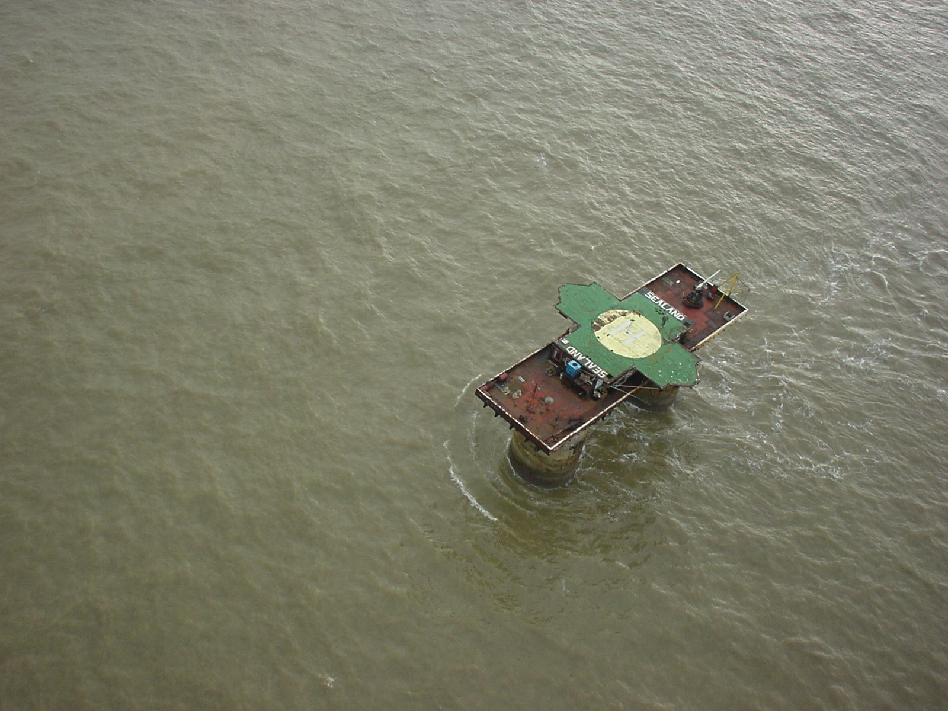
Sealand

Slide 7
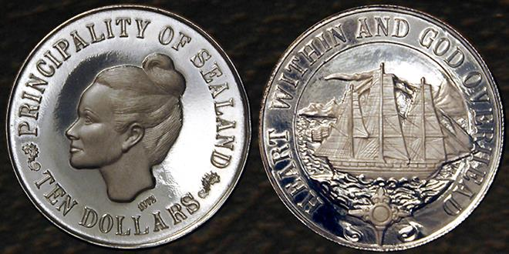

Slide 9
Mark 8:31-33 Jesus ambition was to please the Father. His heart was for the whole world.

Slide 10
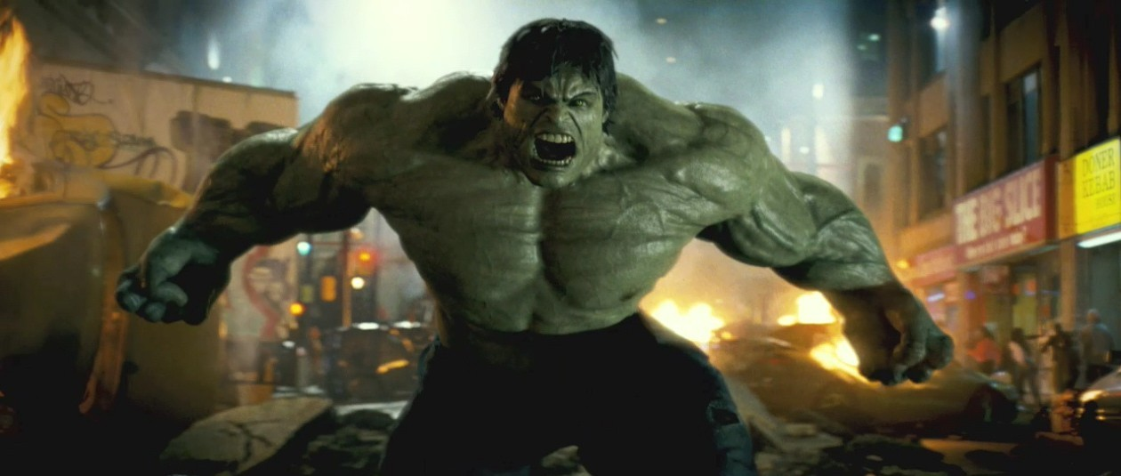

Slide 11
Mark 8:31-33 Jesus ambition was to please the Father. His heart was for the whole world.

Slide 12
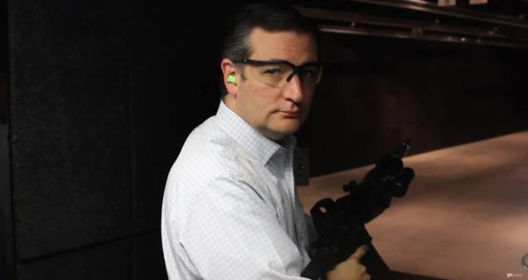

Slide 15
Mark 8:34-38 Disciples give up their lives for Jesus and the Gospel.

Slide 16
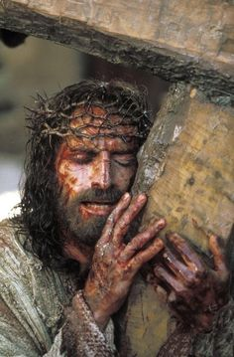

Slide 17
Mark 8:34-38 Disciples give up their lives for Jesus and the Gospel.

Slide 18
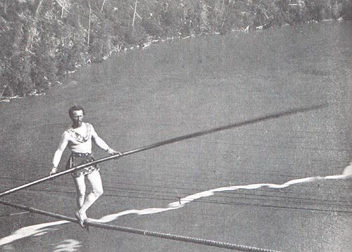

Slide 19
Go

Slide 20
Go Grow

Slide 21
Go Grow Pray

Slide 22
Go Grow Pray Give

